Slide 1

ML using Python Session 5
Nabajyoti Pathak

Slide 2
Agenda
Introduction to Classification
Logistic Regression
Evaluation of best model
Decision tree

Slide 3
Introduction to Classification
Classification techniques are an essential part of machine learning and data mining applications.
Approximately 70% of problems in Data Science are classification problems.
There are lots of classification problems that are available, but the logistics regression is common and is a useful regression method for solving the binary classification problem.

Slide 4
Multinomial classification
Another category of classification is Multinomial classification, which handles the issues where multiple classes are present in the target variable.
For example, IRIS dataset a very famous example of multi-class classification.

Slide 5
Logistic Regression
Logistic Regression can be used for various classification problems such as spam detection.
Diabetes prediction, if a given customer will purchase a particular product or will they churn another competitor, whether the user will click on a given advertisement link or not, and many more examples

Slide 6
Logistic Regression
Logistic regression is a statistical method for predicting binary classes. The outcome or target variable is dichotomous in nature. Dichotomous means there are only two possible classes.
For example, it can be used for cancer detection problems. It computes the probability of an event occurrence.
It is a special case of linear regression where we have discrete target variable instead of continuous.
It uses a log of odds as the dependent variable. Logistic Regression predicts the probability of occurrence of a binary event utilizing a logit function.

Slide 7
Odds and Odds Ratio
Odds of an event happening is defined as the likelihood that an event will occur, expressed as a proportion of the likelihood that the event will not occur.
Therefore, if A is the probability of subjects affected and B is probability of subjects not affected, then odds = A /B.
Odds Ratio (OR) is a measure of association between exposure and an outcome. The OR represents the odds that an outcome will occur given a particular exposure, compared to the odds of the outcome occurring in the absence of that exposure.

Slide 8

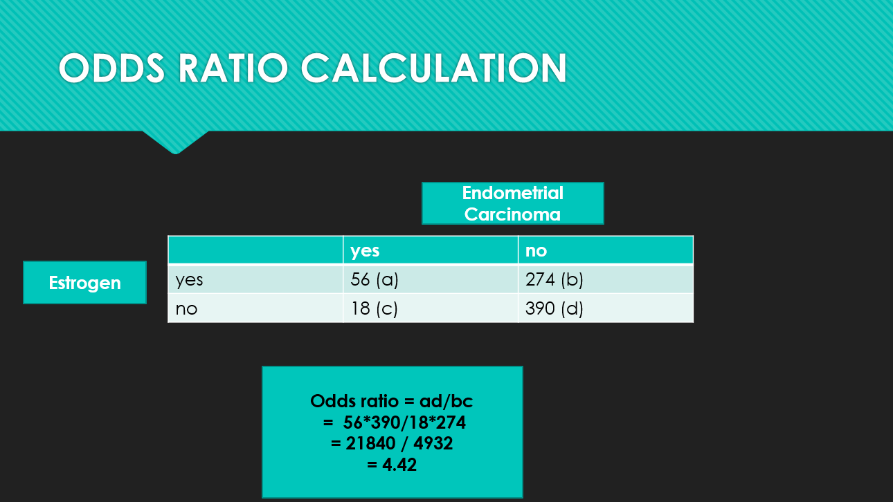
Odds and Odds Ratio

Slide 9
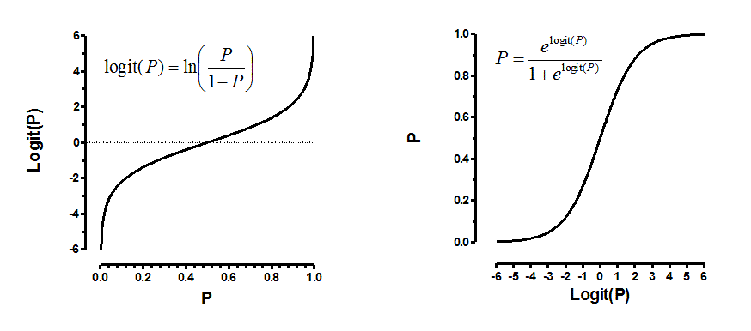
Logit Function
Logistic regression is an estimate of a logit function. Here is how the logit function looks like:
Natural log of odds ratio is call logit function

Slide 10
Sigmoid Function
The sigmoid function, also called logistic function gives an ‘S’ shaped curve that can take any real-valued number and map it into a value between 0 and 1.
If the curve goes to positive infinity, y predicted will become 1, and if the curve goes to negative infinity, y predicted will become 0.
If the output of the sigmoid function is more than 0.5, we can classify the outcome as 1 or YES, and if it is less than 0.5, we can classify it as 0 or NO.
For example: If the output is 0.75, we can say in terms of probability as: There is a 75 percent chance that patient will suffer from cancer.

Slide 11
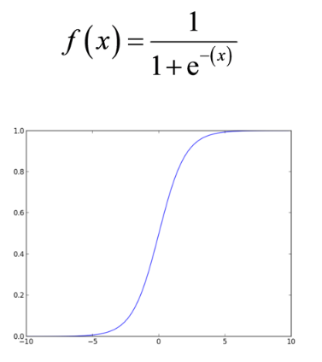
Sigmoid Function

Slide 12
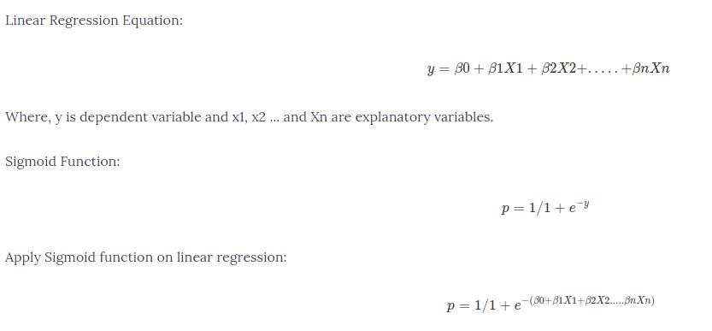
Linear VS Logistic Regression

Slide 13
Properties of Logistic Regression
The dependent variable in logistic regression follows Bernoulli Distribution.
Estimation is done through maximum likelihood.
No R Square, Model fitness is calculated through confusion metrics

Slide 14
Linear Regression Vs. Logistic Regression
Linear regression gives you a continuous output, but logistic regression provides a constant output.
An example of the continuous output is house price and stock price. Example's of the discrete output is predicting whether a patient has cancer or not, predicting whether the customer will churn.
Linear regression is estimated using Ordinary Least Squares (OLS) while logistic regression is estimated using Maximum Likelihood Estimation (MLE) approach.

Slide 15
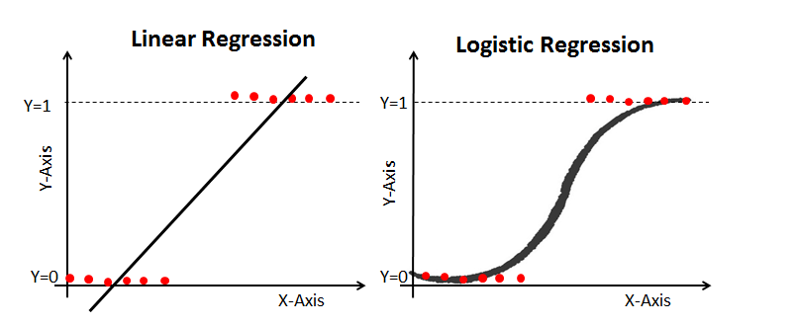
Graph

Slide 16
Maximum Likelihood Estimation Vs. Least Square Method
The MLE is a "likelihood" maximization method, while OLS is a distance-minimizing approximation method. Maximizing the likelihood function determines the parameters that are most likely to produce the observed data. From a statistical point of view, MLE sets the mean and variance as parameters in determining the specific parametric values for a given model. This set of parameters can be used for predicting the data needed in a normal distribution.
Ordinary Least squares estimates are computed by fitting a regression line on given data points that has the minimum sum of the squared deviations (least square error). Both are used to estimate the parameters of a linear regression model. MLE assumes a joint probability mass function, while OLS doesn't require any stochastic assumptions for minimizing distance.

Slide 17
Types of Logistic Regression
Binary Logistic Regression: The target variable has only two possible outcomes such as Spam or Not Spam, Cancer or No Cancer.
Multinomial Logistic Regression: The target variable has three or more nominal categories such as predicting the type of Wine.

Slide 18
Model building -Steps
Loading Data
Data Cleaning
Selecting Feature
Train-Test Split
Model Building
Model Evaluation (Confusion Metrics)

Slide 19
Selecting Feature
Here, you need to divide the given columns into two types of variables dependent(or target variable) and independent variable(or feature variables).

Slide 20
Splitting Data
To understand model performance, dividing the dataset into a training set and a test set is a good strategy.
Additionally, you can use random_state to select records randomly.

Slide 21
Model Development and Prediction
First, import the Logistic Regression module and create a Logistic Regression classifier object using LogisticRegression() function.
Then, fit your model on the train set using fit() and perform prediction on the test set using predict().

Slide 22
Performance of Logistic Regression Model
To evaluate the performance of a logistic regression model, we must consider few metrics. Irrespective of tool (SAS, R, Python) you would work on, always look for:
Confusion Matrix
ROC

Slide 23
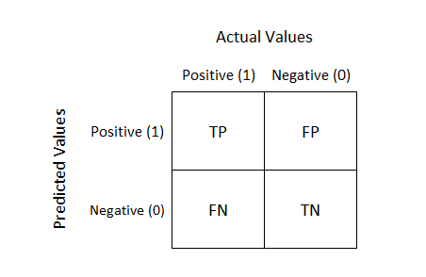
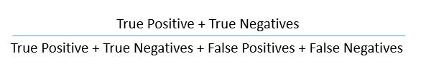
Confusion Matrix
It is nothing but a tabular representation of Actual vs Predicted values.
This helps us to find the accuracy of the model and avoid overfitting. This is how it looks like:
Calculate the accuracy of your model with:

Slide 24


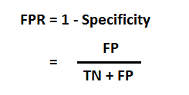
Confusion Matrix
From confusion matrix, Specificity and Sensitivity can be derived as illustrated below:
Specificity and Sensitivity plays a crucial role in deriving ROC curve.

Slide 25
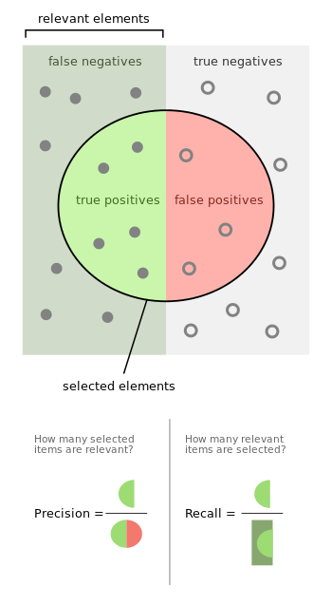

Slide 26
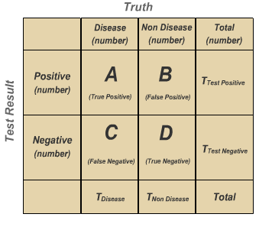
Sensitivity vs Specificity
Sensitivity is the probability that a test will indicate 'disease' among those with the disease:
Sensitivity: A/(A+C) × 100
Specificity is the fraction of those without disease who will have a negative test result:
Specificity: D/(D+B) × 100

Slide 27
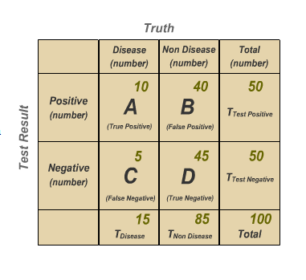
Example
100 people are tested for disease. 15 people have the disease; 85 people are not diseased.
Prevalence of Disease: T_{disease}/ Total × 100, 15/100 × 100 = 15%
Sensitivity: A/(A + C) × 100 10/15 × 100 = 67%
Sensitivity is two-thirds, so the test is able to detect two-thirds of the people with disease. The test misses one-third of the people who have disease.
Specificity: D/(D + B) × 100 45/85 × 100 = 53%
The test has 53% specificity. In other words, 45 persons out of 85 persons with negative results are truly negative and 40 individuals test positive for a disease which they do not have.

Slide 28
Spam Filter (+ve class is spam)
Identify whether to optimize sensitivity or specificity?
*Normal mail should not be predicted as spam.

Slide 29
Fraudulent Transaction(+ve class is fraud)
Identify whether to optimize sensitivity or specificity?
*Fraud should not be predicted as normal.

Slide 30
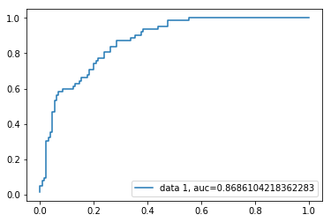
ROC Curve
Receiver Operating Characteristic(ROC) curve is a plot of the true positive rate against the false positive rate. It shows the tradeoff between sensitivity and specificity.
AUC score for the case is 0.86. AUC score 1 represents perfect classifier, and 0.5 represents a worthless classifier.

Slide 31
What is AUC - ROC Curve?
AUC - ROC curve is a performance measurement for classification problem at various thresholds settings. ROC is a probability curve and AUC represents degree or measure of separability.
It tells how much model is capable of distinguishing between classes.
Higher the AUC, better the model is at predicting 0s as 0s and 1s as 1s. By analogy, Higher the AUC, better the model is at distinguishing between patients with disease and no disease.

Slide 32
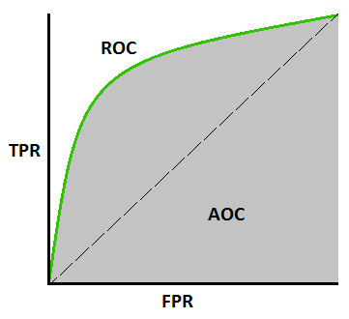
ROC Curve
An excellent model has AUC near to the 1 which means it has good measure of separability.
A poor model has AUC near to the 0 which means it has worst measure of separability.
In fact it means it is reciprocating the result. It is predicting 0s as 1s and 1s as 0s. And when AUC is 0.5, it means model has no class separation capacity whatsoever.
The ROC curve is plotted with TPR against the FPR (False Positive Rate) where TPR (True Positive Rate)is on y-axis and FPR is on the x-axis.

Slide 33
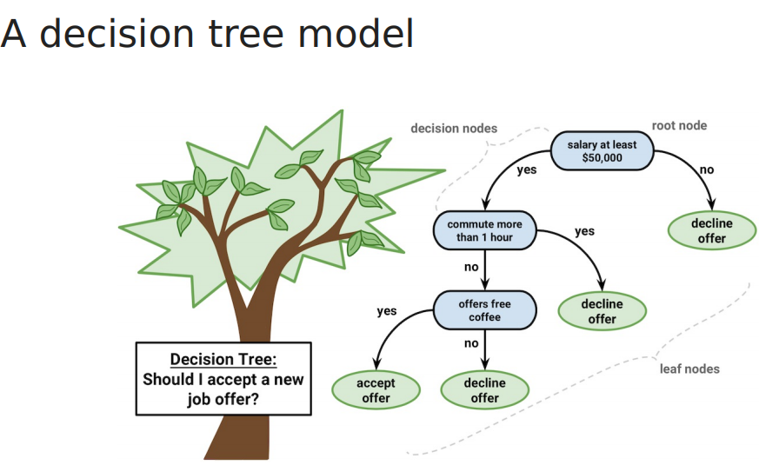
Decision Tree

Slide 34
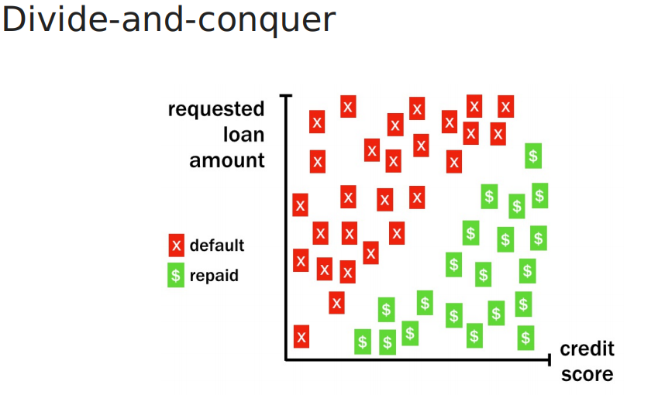

Slide 35
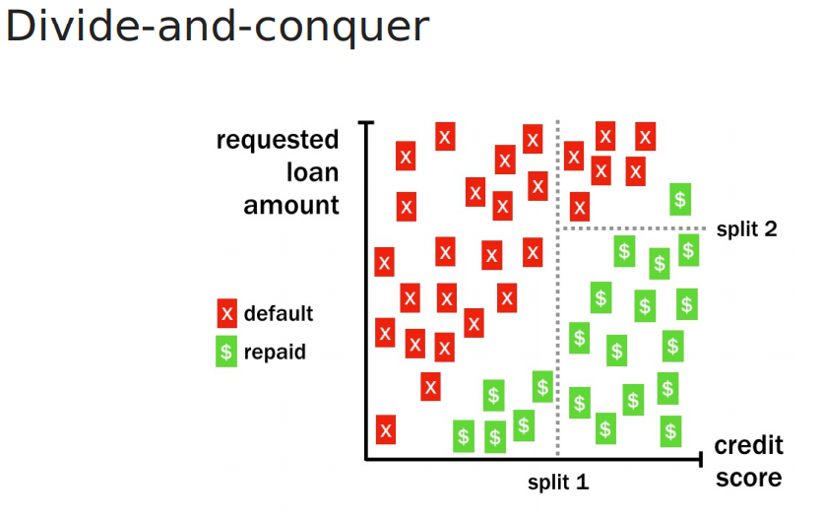

Slide 36
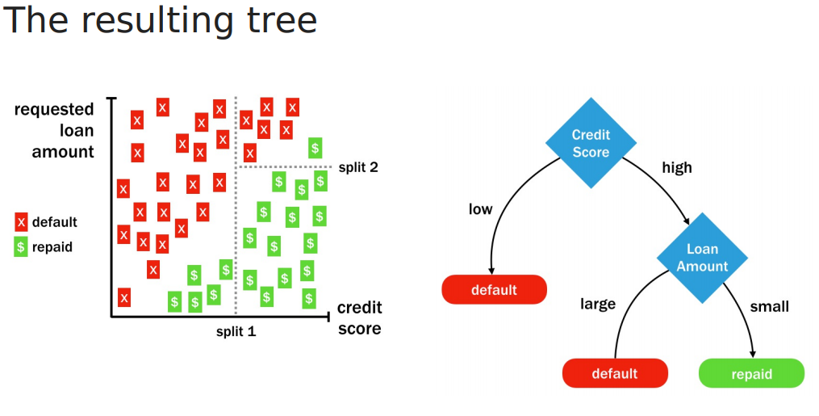

Slide 37
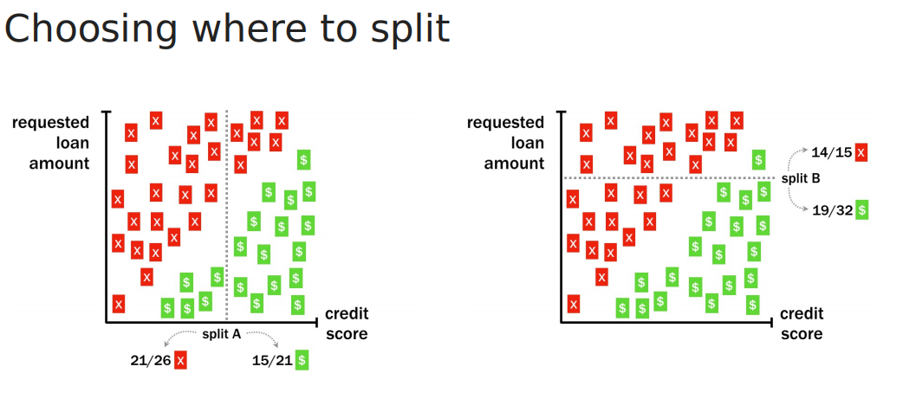

Slide 38
Measure for Selecting the best Split
Entropy
Gini
Classification error

Slide 39
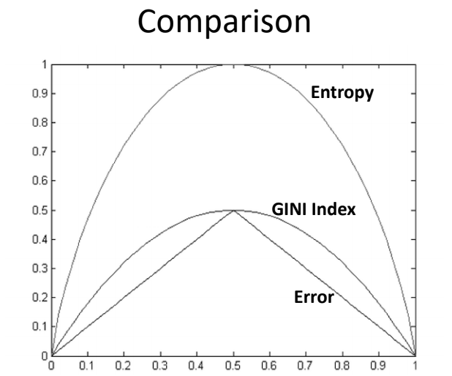

Slide 40
Gini Index
Gini index says, if we select two items from a population at random then they must be of same class and probability for this is 1 if population is pure.
It works with categorical target variable “Success” or “Failure”.
It performs only Binary splits
Higher the value of Gini higher the homogeneity.
CART (Classification and Regression Tree) uses Gini method to create binary splits.

Slide 41
Steps to Calculate Gini for a split
Calculate Gini for sub-nodes, using formula sum of square of probability for success and failure (p^2+q^2).
Calculate Gini for split using weighted Gini score of each node of that split

Slide 42
Example
Referring to example used above, where we want to segregate the students based on target variable ( playing cricket or not ). In the snapshot below, we split the population using two input variables Gender and Class. Now, I want to identify which split is producing more homogeneous sub-nodes using Gini index.

Slide 43
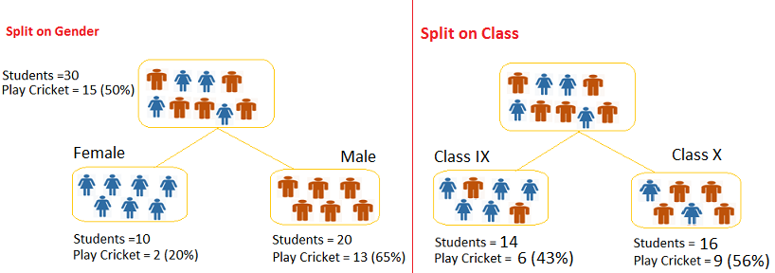
Example
Split on Gender:
Calculate, Gini for sub-node Female = (0.2)*(0.2)+(0.8)*(0.8)=0.68
Gini for sub-node Male = (0.65)*(0.65)+(0.35)*(0.35)=0.55
Calculate weighted Gini for Split Gender = (10/30)*0.68+(20/30)*0.55 = 0.59
Similar for Split on Class:
Gini for sub-node Class IX = (0.43)*(0.43)+(0.57)*(0.57)=0.51
Gini for sub-node Class X = (0.56)*(0.56)+(0.44)*(0.44)=0.51
Calculate weighted Gini for Split Class = (14/30)*0.51+(16/30)*0.51 = 0.51
**you can see that Gini score for Split on Gender is higher than Split on Class, hence, the node
split will take place on Gender.

Slide 44
Entropy
Entropy can be calculated using formula:-
Here p and q is probability of success and failure respectively in that node. Entropy is also used with categorical target variable.
It chooses the split which has lowest entropy compared to parent node and other splits. The lesser the entropy, the better it is.

Slide 45
Entropy
Steps to calculate entropy for a split:
Calculate entropy of parent node
Calculate entropy of each individual node of split and calculate weighted average of all sub-nodes available in split.

Slide 46
Example
Example: Let’s use this method to identify best split for student example.
Entropy for parent node = -(15/30) log2 (15/30) – (15/30) log2 (15/30) = 1. Here 1 shows that it is a impure node.
Entropy for Female node = -(2/10) log2 (2/10) – (8/10) log2 (8/10) = 0.72 and for male node, -(13/20) log2 (13/20) – (7/20) log2 (7/20) = 0.93
Entropy for split Gender = Weighted entropy of sub-nodes = (10/30)*0.72 + (20/30)*0.93 = 0.86
Entropy for Class IX node, -(6/14) log2 (6/14) – (8/14) log2 (8/14) = 0.99 and for Class X node, -(9/16) log2 (9/16) – (7/16) log2 (7/16) = 0.99.
Entropy for split Class = (14/30)*0.99 + (16/30)*0.99 = 0.99
Above, you can see that entropy for Split on Gender is the lowest among all, so the tree will split on Gender. We can derive information gain from entropy as 1- Entropy.

